Slide 1




inside
Minority Owned & Ethnicity

Slide 2

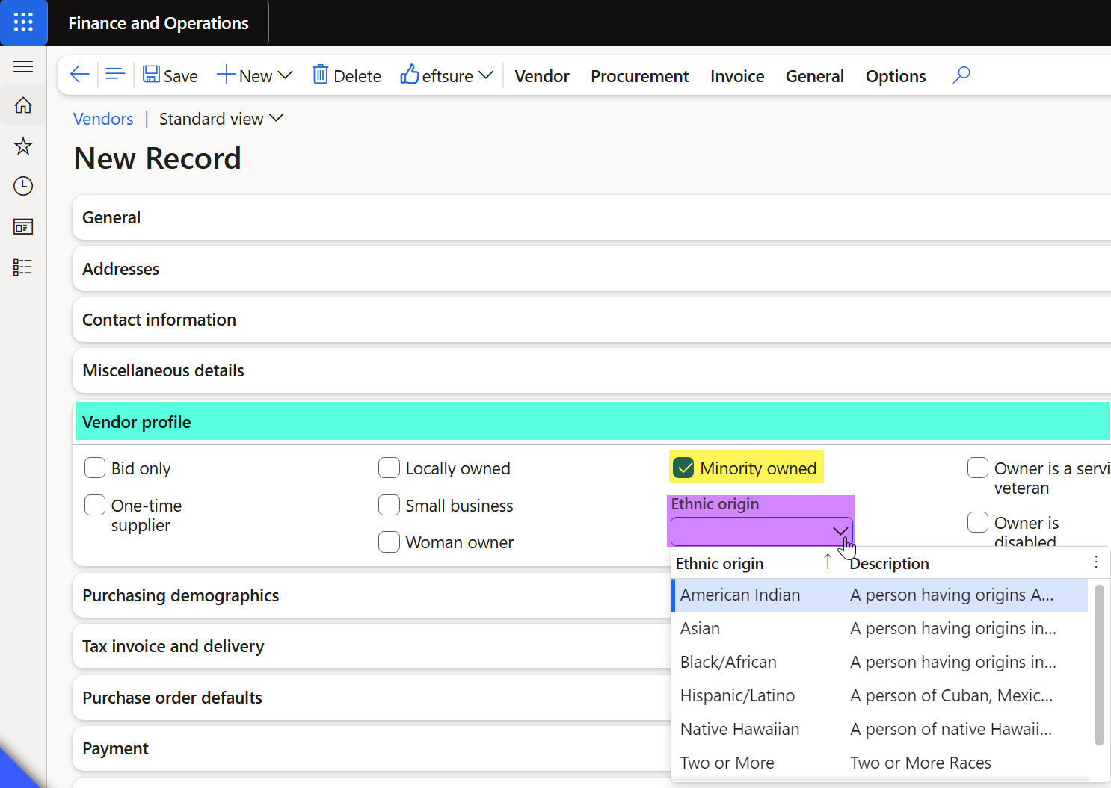
Feature overview
in Dynamics 365 F&O

Slide 3
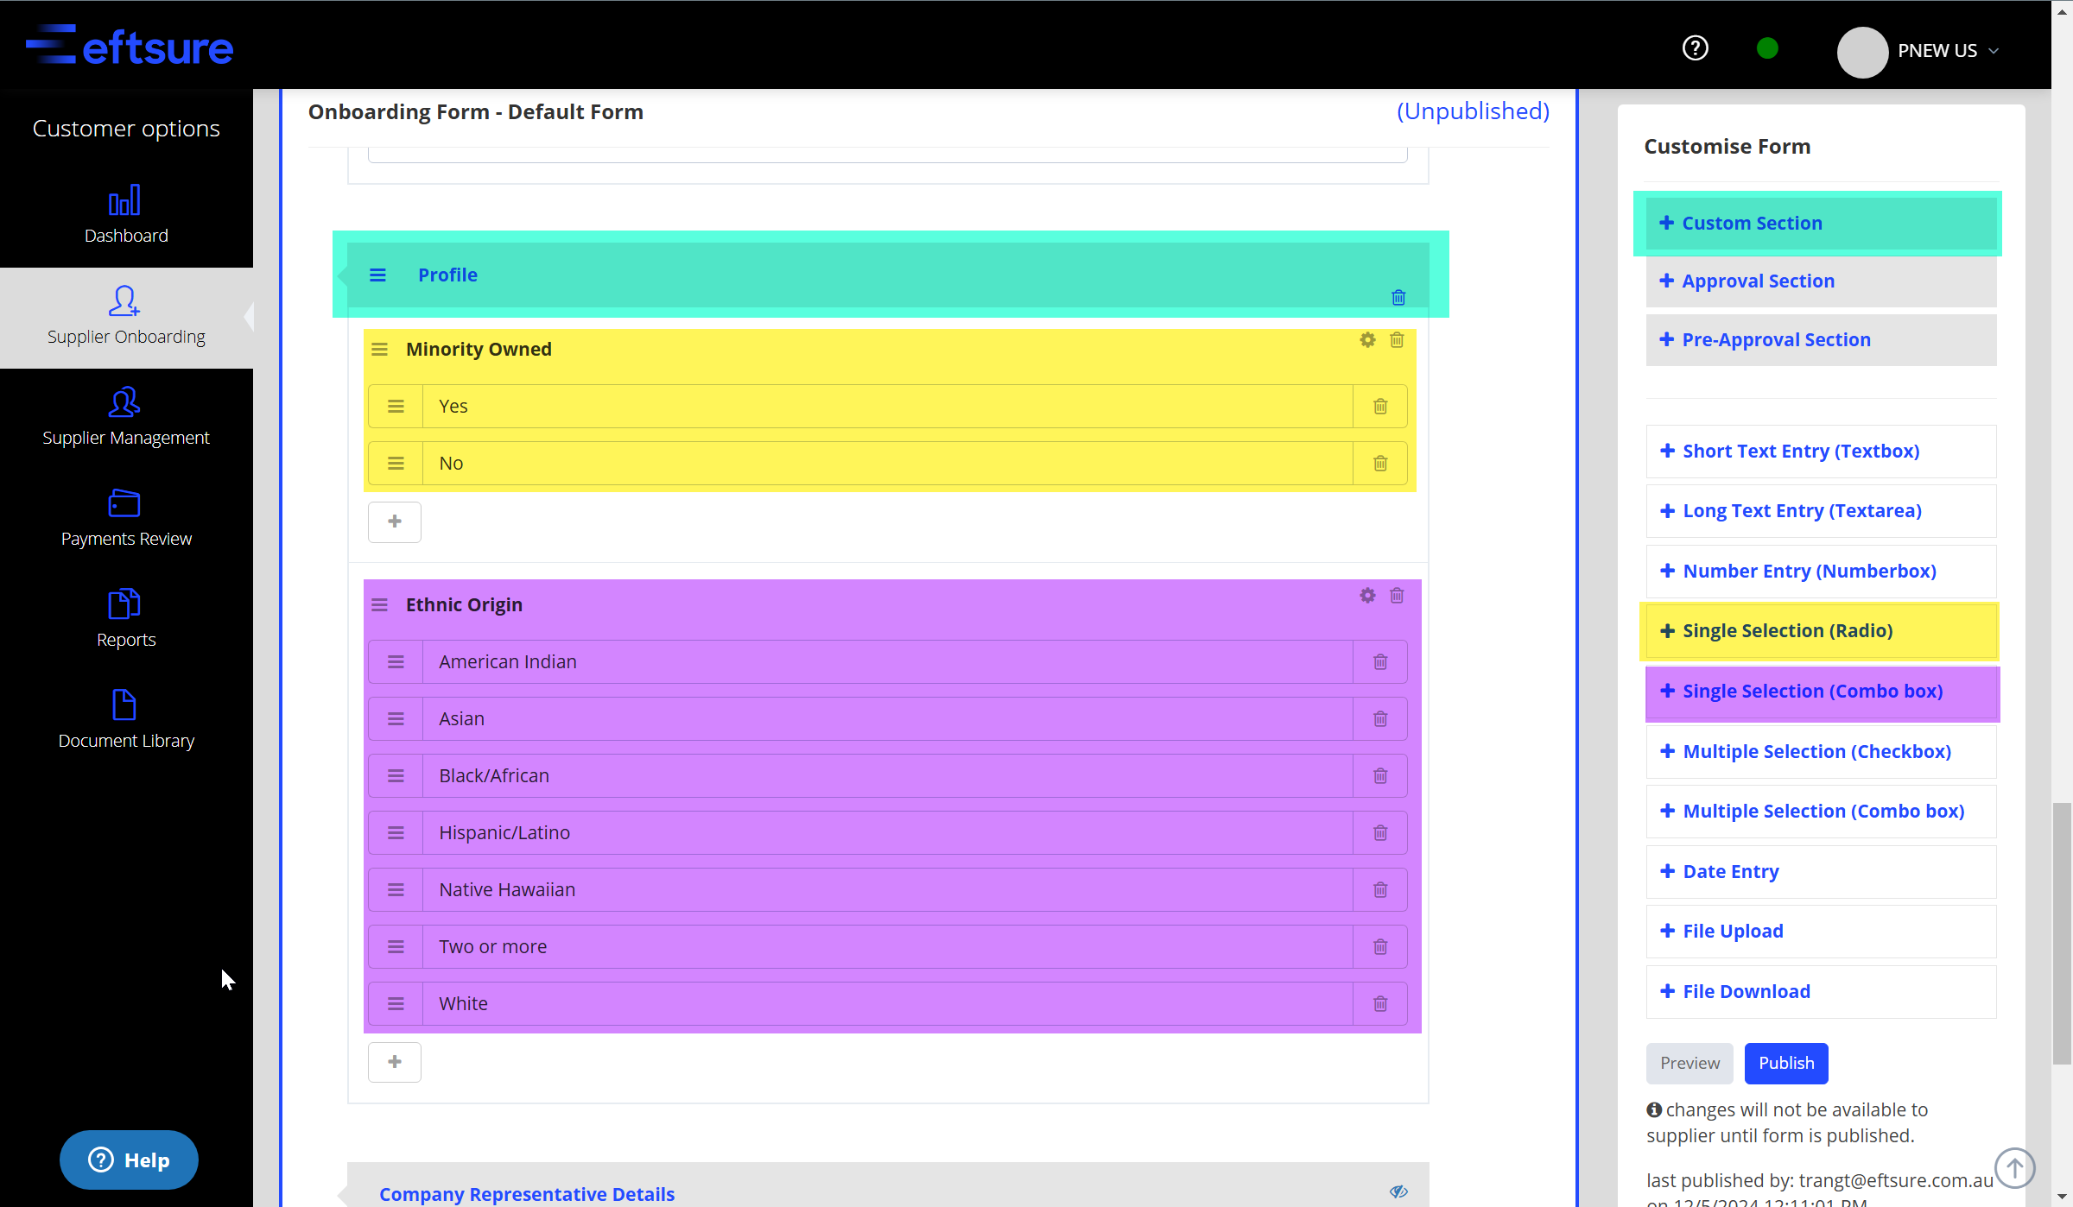
Proposed solution in onboarding form

Slide 4
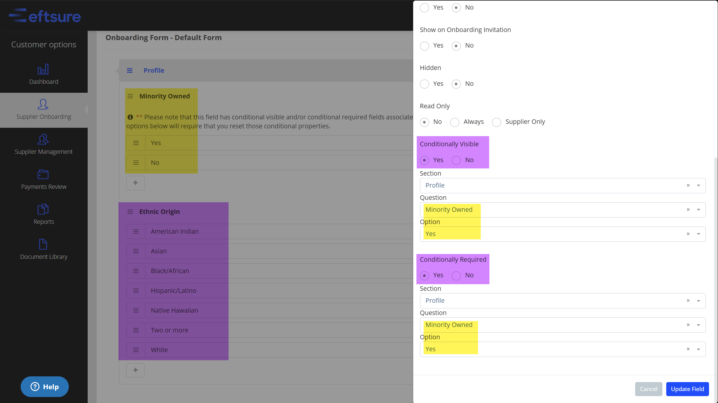
Setup for Ethnic Origin
In eftsure portal

Slide 5
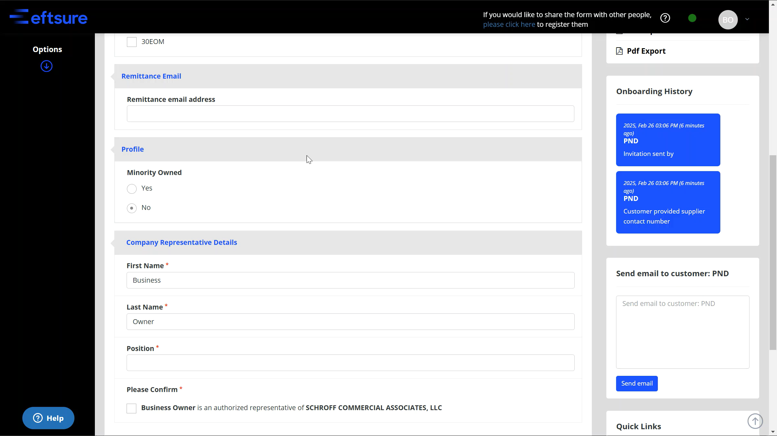
Onboarding form
During vendor registration

Slide 6
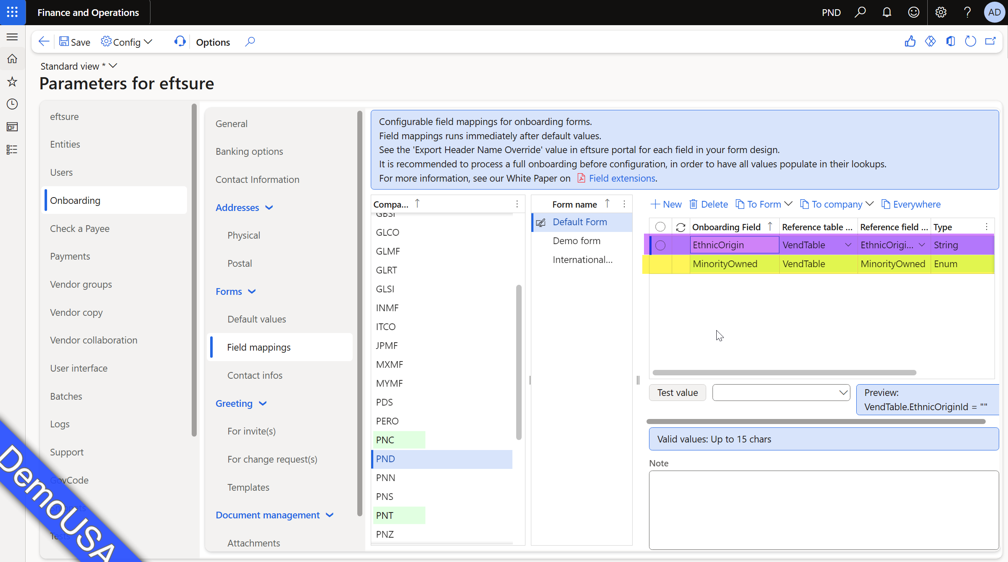
Onboarding Form configuration
in Dynamics 365 F&O

Slide 7
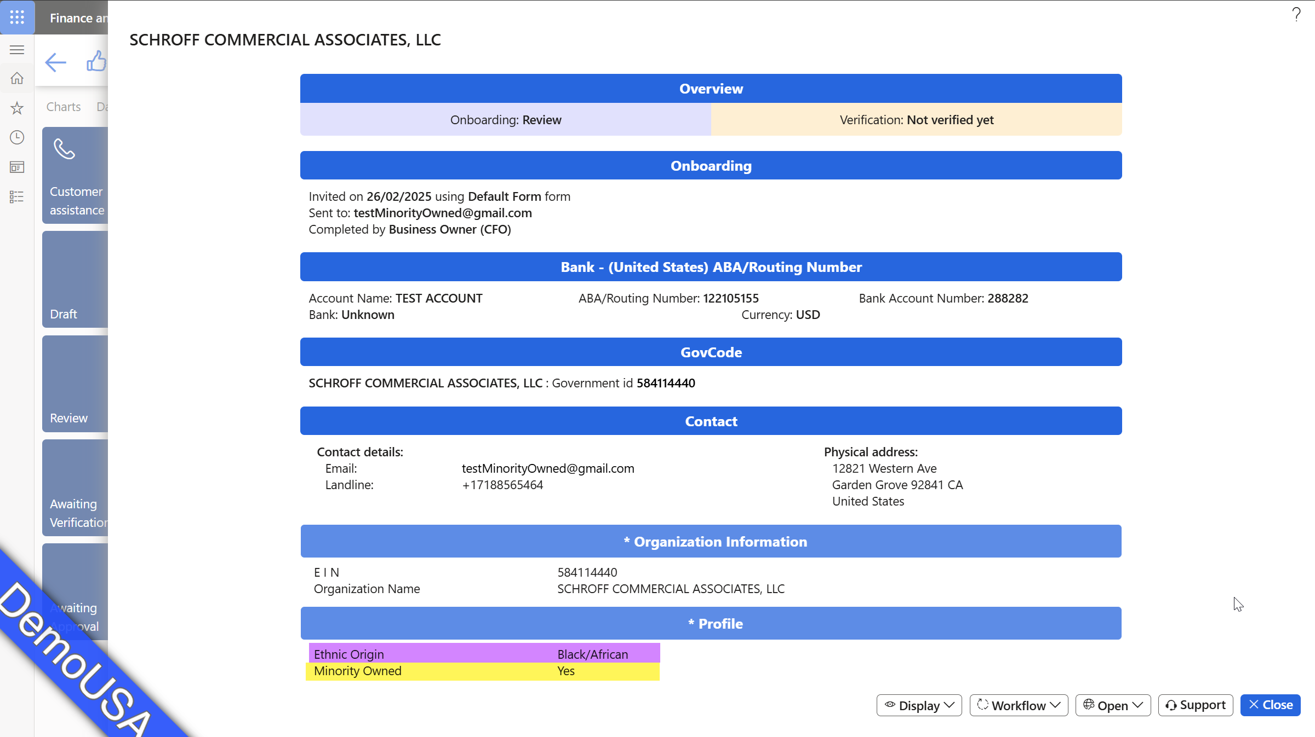
Onboarding review
In Dynamics 365 F&O

Slide 8
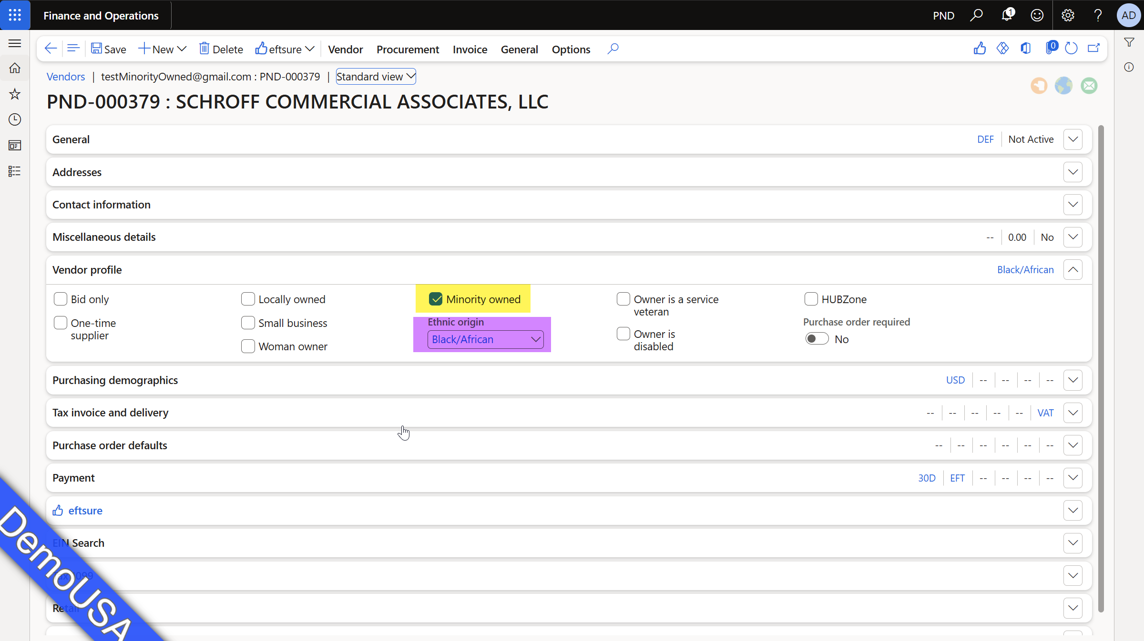
Created vendor
In Dynamics 365 F&O

